Slide 1
The DXC Dandelion Work Experience Program
Brisbane 2018

Slide 2
Agenda
Welcome
Feedback Forms
DXC Dandelion Program Overview
Introduction to Work Experience Program Members
Presentation from the Team
Demonstration
Q&A

Slide 3

Feedback Forms

Slide 4

DXC Dandelion Program “Changing lives and our workplace”
Vision:
The Dandelion Program’s aim is to build the careers of people on the autism spectrum and instill the confidence in other organisations that with the correct framework, will benefit from the diversity of people on the autism spectrum.
Success to date:
In just over three years we have established 6 teams in 4 states, across Australia spanning a range of IT roles and now employ 60+ people on the spectrum.
Canberra 3 x teams – Cybersecurity, Analytics, Automation and monitoring, Testing
Brisbane – Test team
Adelaide – Test Team
Melbourne – Test Team & Cyber Security

Slide 5
Team Members
Program Co-ordinator / Facilitator
Felicia Vozzo
Technical Lead
Corey Jansen
Autism Support Consultant
Sharon Whip
Development Team
Bailey, Finnian, Jayden, Jed, Jordan, Justin, Madison, Natalie, Nicole & Sarah

Slide 6
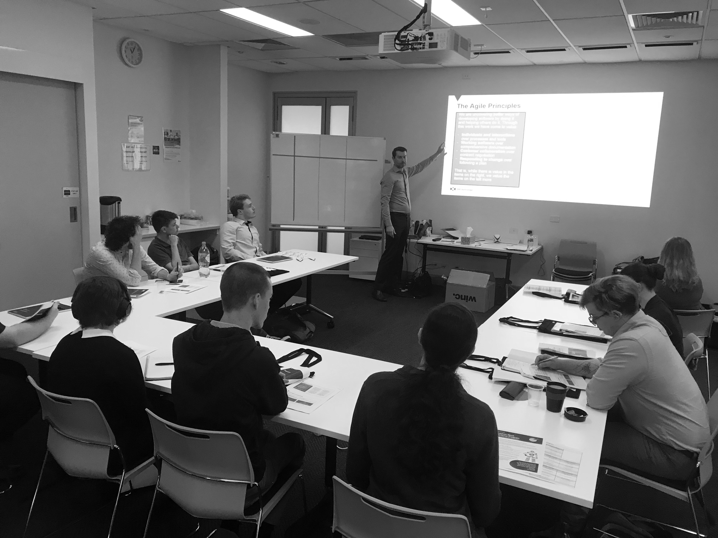
Agile Delivery Team

Slide 7

Project Overview
What is the project?
Why are we doing it?

Slide 8






Agile Scrum framework
Start of Sprint
Product backlog
User stories
Story points
Sprint planning
Daily
Stand-up
Scrum Master
Development Team
Sprint Planning
Sprint Iteration
(1-4 weeks)
During the Sprint
The work
Daily stand-up meeting
Running tested features
Backlog refinement
Sprint Review
Sprint Retrospective
Product Backlog
Sprint
Backlog
Backlog Refinement
End of Sprint
Sprint review
Sprint retrospective
Product Owner
Potentially Shippable
Product Increment
Notes:
Go through this fast.
Will be going through each of the parts of the framework in the next slides, the ceremonies, the roles and the artifacts
Backlog refinement, clarify stories and estimate, no more than 10%

Slide 9
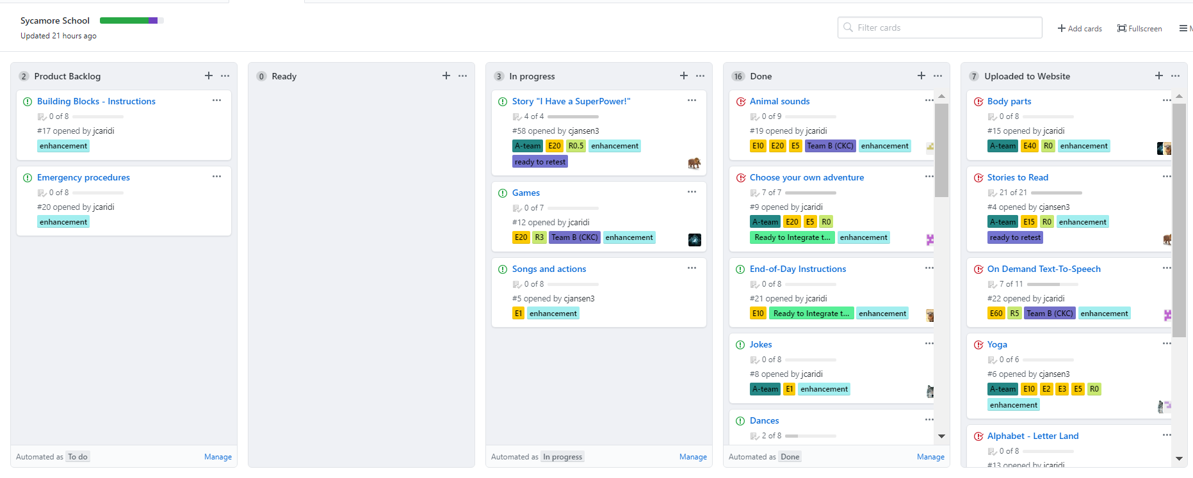
Backlog

Slide 10
Backlog
We have created many different activities for the students to play with the robot, including:
Body Parts
Stories to Read
On demand Text-To-Speech
Yoga
Alphabet
Words on command
Cooking Steps
Animal Sounds
Choose your own adventure
End-of-day Instructions
Jokes
Dances
Wellbeing Expectations
Fun Facts
Maths
Zones of Regulation
Meditation

Slide 11
Sprint Overview
Sprint 1:
Prioritised the Product Backlog and created estimates per task
Worked with an 250 hour capacity
Split into two groups of 5
Focused on working through the highest prioritised tasks
Sprint 2:
Worked on the remaining backlog
Evenly distributed the remaining work

Slide 12
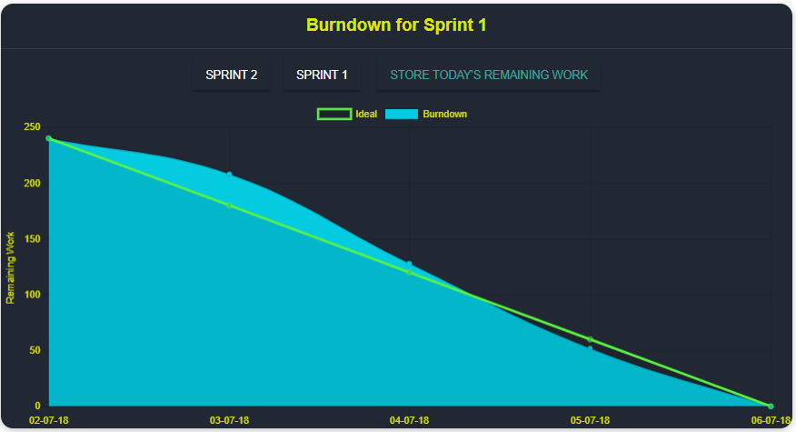
Sprint Overview – Burndown Chart

Slide 13
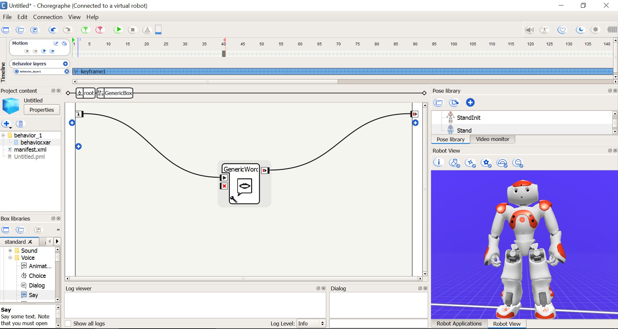
Choregraphe
Keyframe/Behaviour
Layer
Pose Stored
Python-Based
User-Friendly Interface
Virtual Robot
Signal sent
Box containing behaviour
Signal terminal
(end behaviour)
Virtual robot

Slide 14
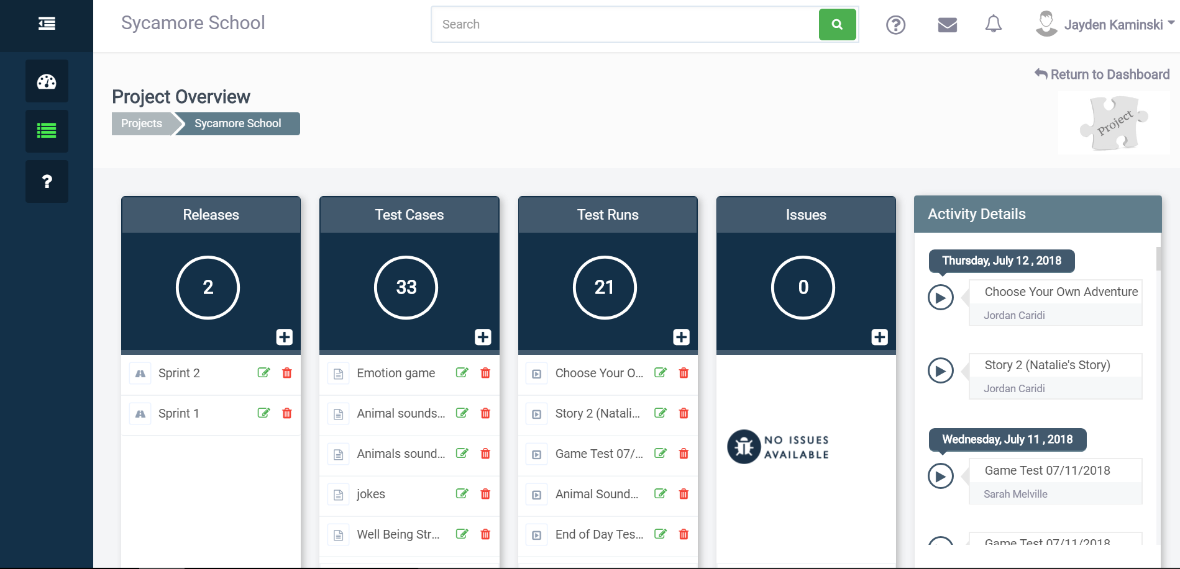
Testing phase

Slide 15
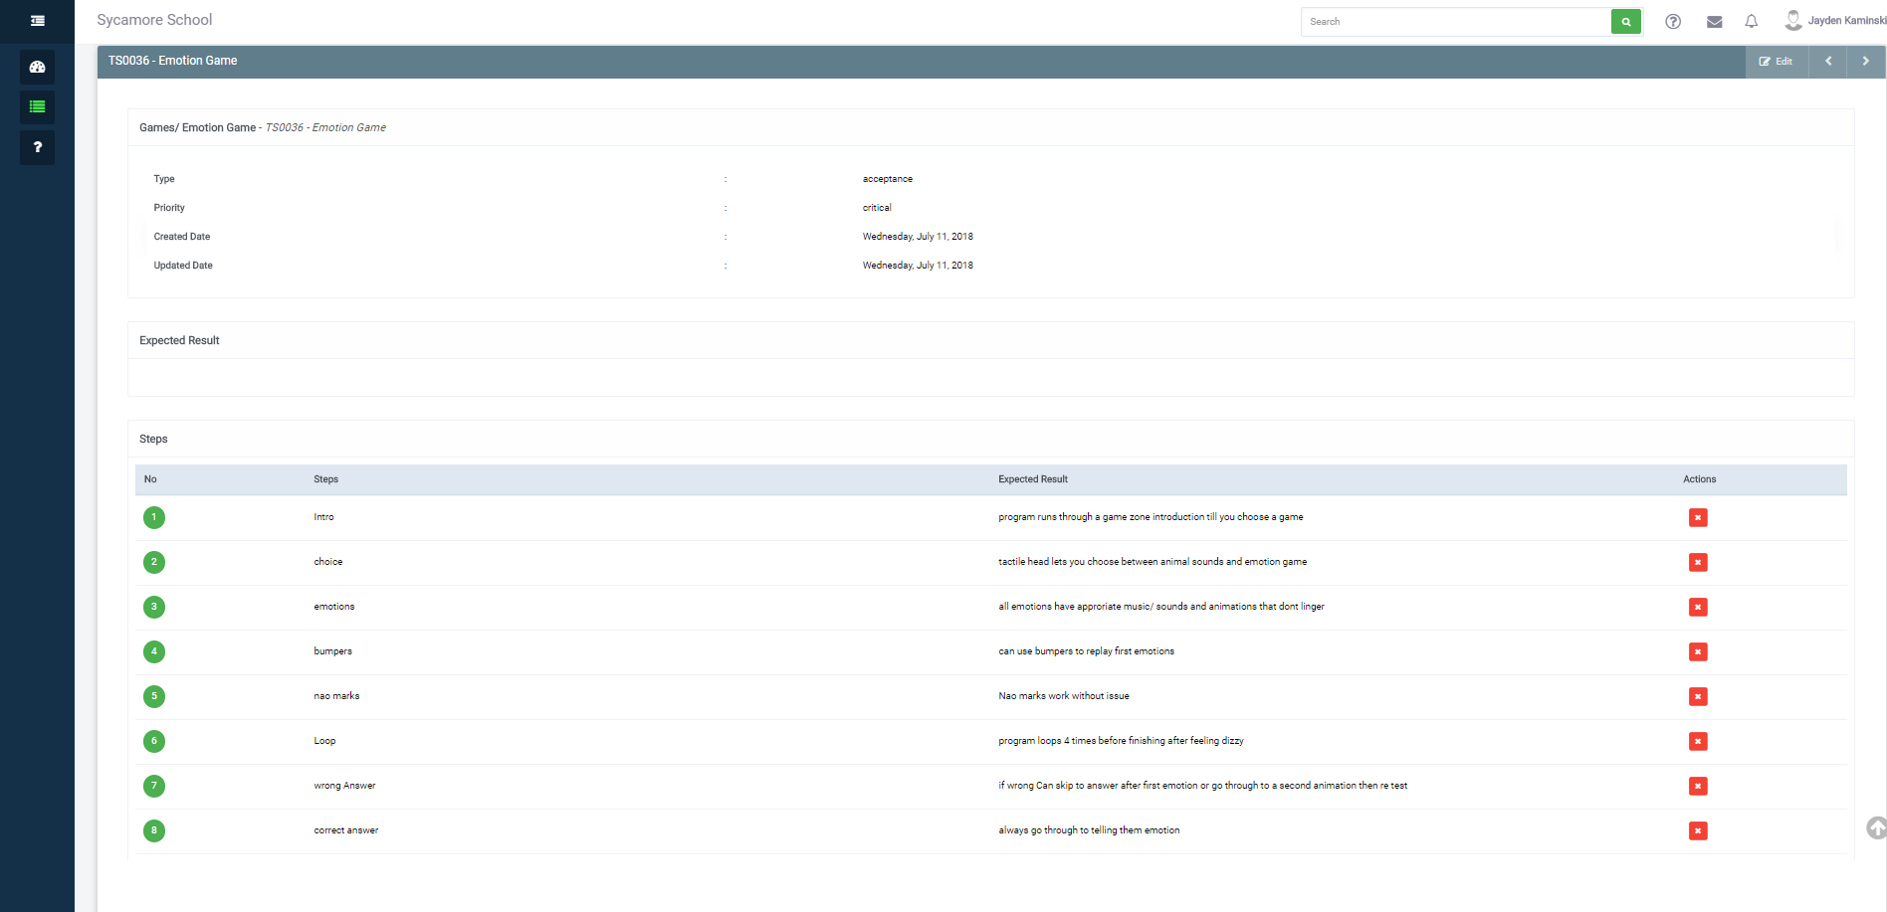
Test cases

Slide 16
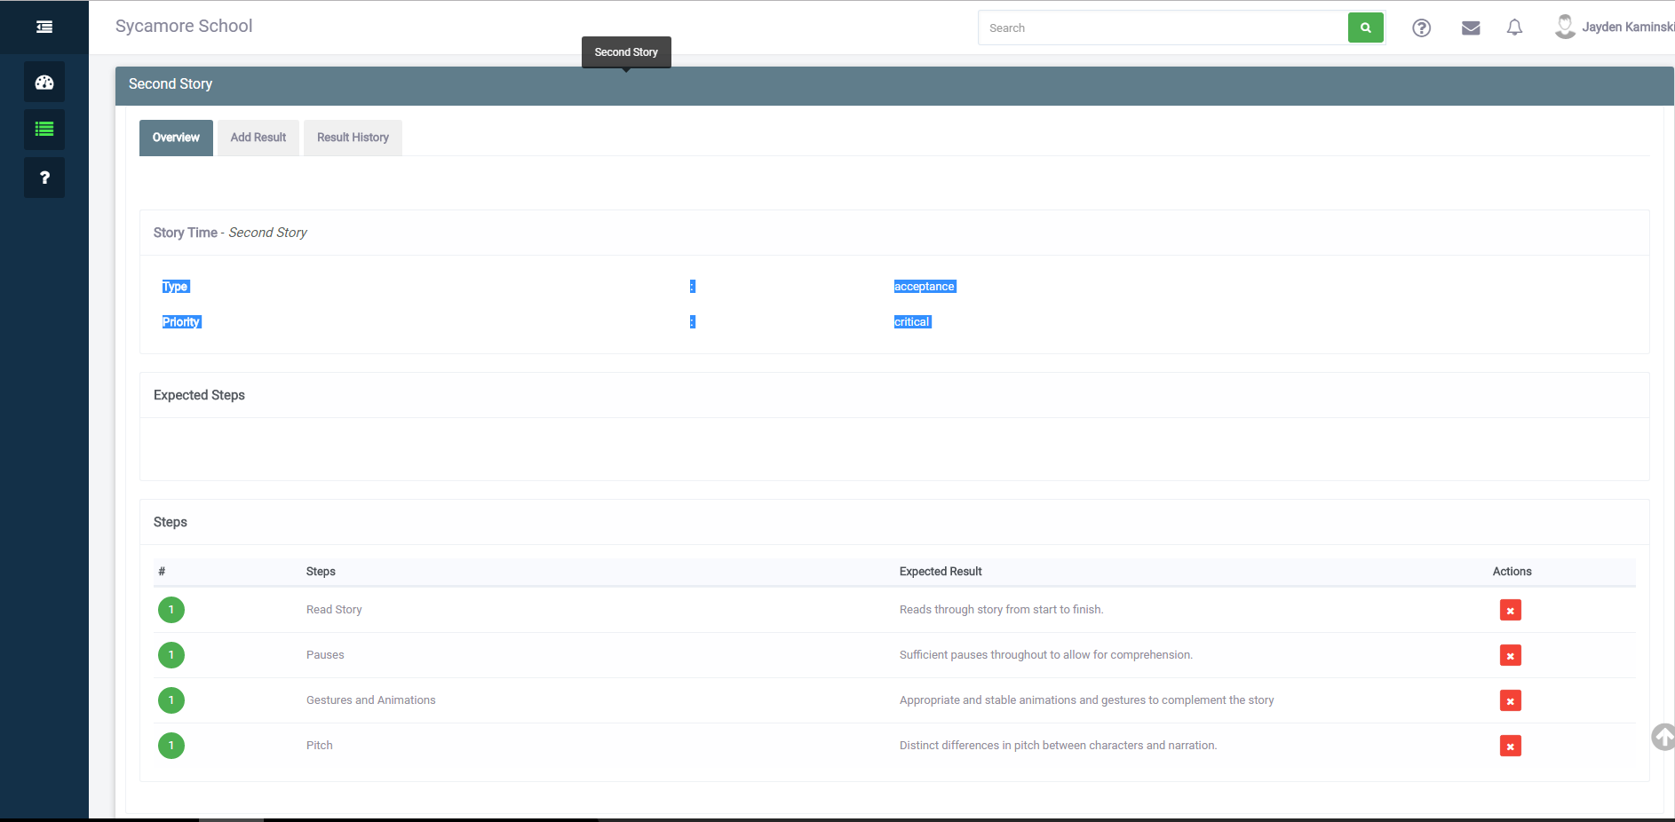
Test runs

Slide 17
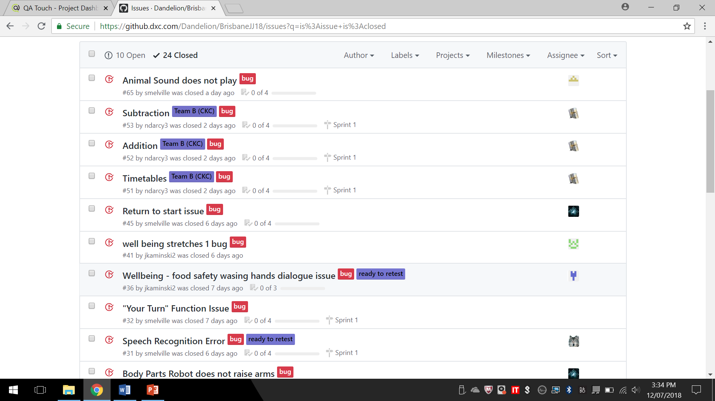
Issues

Slide 18

Documentation
Why we do documentation:
Documentation can be underrated, especially with Waterfall projects, where documentation is done once.
Documentation should happen at the start of a project.
Agile projects use documentation to store processes, designs, and knowledge.
Some documentation can be delivered with a project.
Team members, clients and stakeholders benefit from it
Notes:
First Slide (Why)
The documentation process can be an underrated portion for most projects. It’s usually kept in the background or left until the last minute. This is especially true when using the Waterfall project module, where documentation is done once, without changing to new requirements.
Documentation is best done in the early stages of a project to define and outline project requirements. Then once the project is underway the process and results should be documented.
With an Agile style project module documentation is used to showcase and store project artifacts and data, record development and design processes, and store developer knowledge.
Some forms of documentation can delivered alongside the project, like technical guides, instruction manuals, marketing material or testimonials.
Team members, clients and stakeholders may greatly benefit from documentations. It can provide a general overview of the development, and provide further detail if the reader requires it.

Slide 19
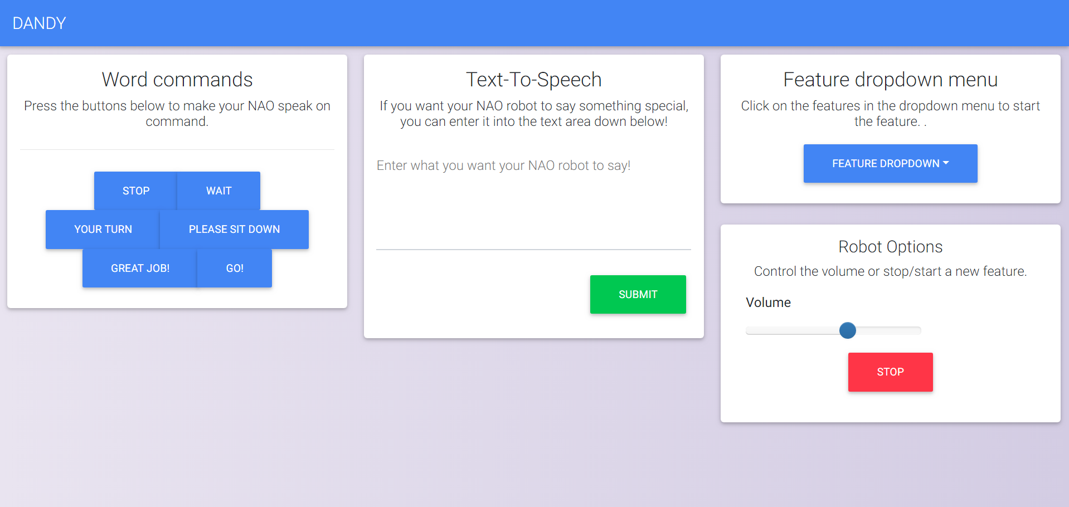
Website
Responsive design; mobile first approach
Clean, minimalistic approach
Main point of contact for users
WebUI starts and stops all features on the robots.

Slide 20
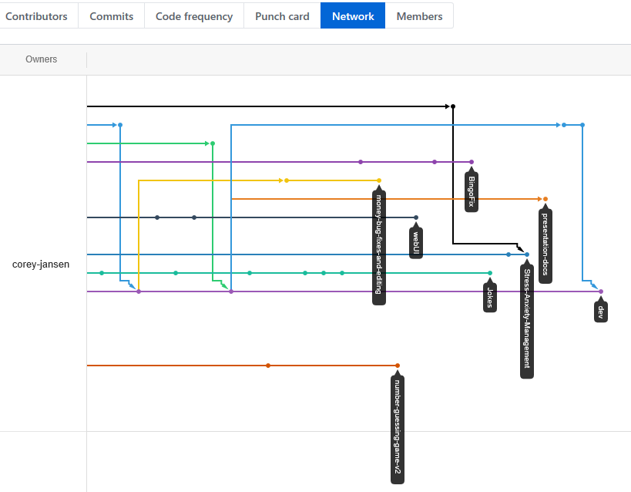
Source Control
What is branching and iteration?
Team members create a branch to work on their own new features.
Version iterations are made to record changes
Old versions backed up in the event of data loss
Branches are integrated into main fork ready for final evaluation
Source control maintains the integrity of the clean master files, avoids conflicts in code

Slide 21
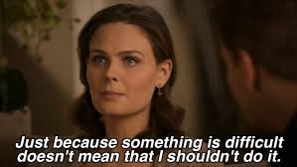
Challenges
Challenges | Resolutions
Robot connection in Choregraphe | Create separate DXC Technology networks
Network confusion | Making sure to disconnect from robots before switching networks
Understanding how to use Choregraphe | Support from Corey & other developers. Also, YouTube videos were used for self-learning
Distributing work among teams and discussing others’ strengths | Sprint retrospectives helped team developers to improve
Mental burnout/concentration issues | Taking regular breaks, self care and not taking work home.
Website integration | Splitting the workload amongst developers
Identifying needs of stakeholders/end users | Communication and discussing with product owner, school and Autism consultant
Leaving testing towards the end | Avoiding mini waterfall strategies and early testing of completed tasks.
Adjusting to a new environment | Adapt, communicate and accepting others needs and offer of support from Autism consultant

Slide 22
How were they challenging?
1) Technical Issues
Robots could not always connect to Choregraphe via Wi-Fi
Virtual robot NAOqi often disconnected during Choregraphe use
Sometimes the robots needed rebooting when they held too much information
2) Coping Methods
Each team member has different personal challenges and adversities
Thus, each person was able to adapt to the new working environment to various degrees and in different ways
3) Team Work
Choosing which task to undertake with many choices of programmes and ideas
4) Understanding Users
Needs differed with various ideas of what would be the best behaviours to implement.

Slide 23
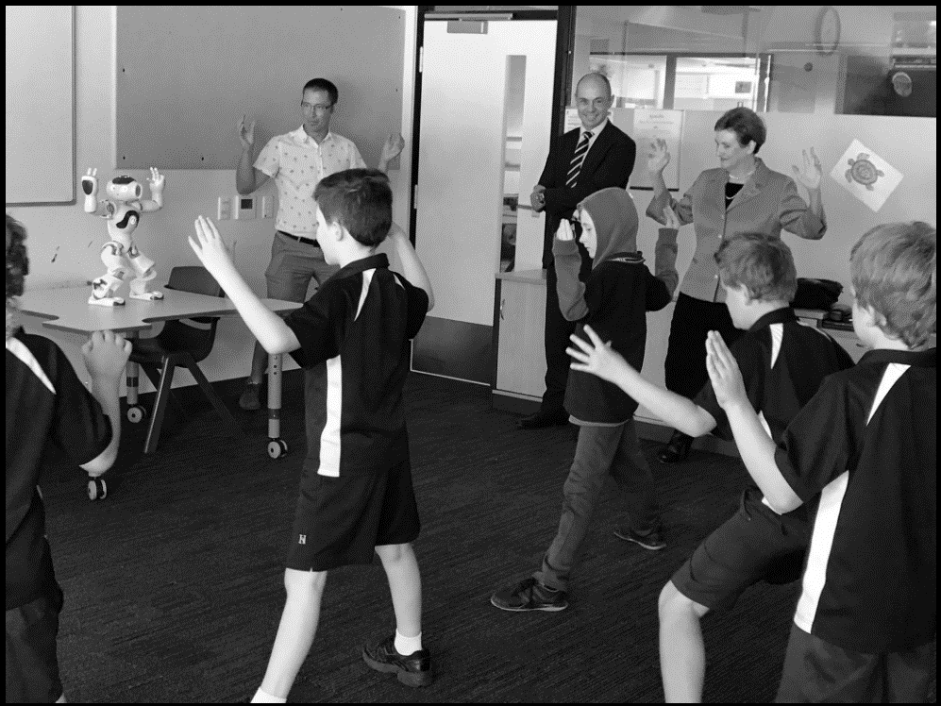
Demonstration

Slide 24
Personal Experience

Slide 25
Q & A

Slide 26
Thank you.

